Slide 1
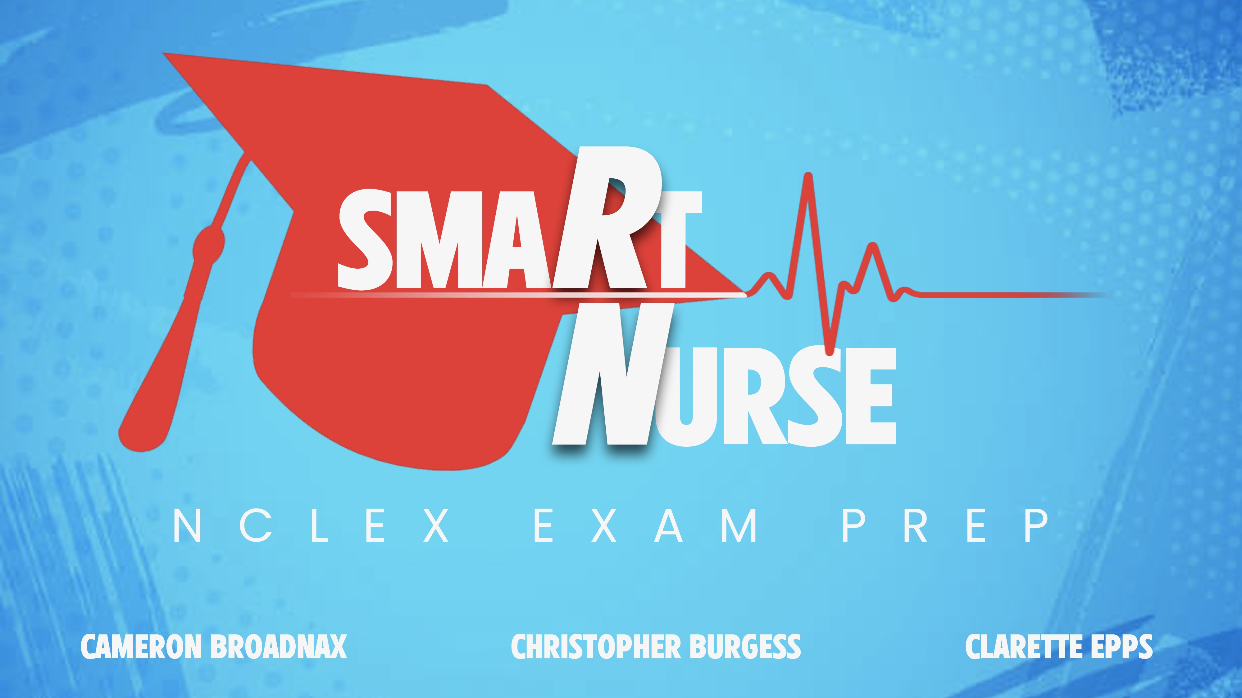
A mobile test prep game for Registered Nursing students preparing to take for the NCLEX exam.

